Slide 1
Lecture 03- Lecture 04
How to write Java code in Eclipse

Slide 2
Typical Steps to to write Java code in Eclipse
Create an Eclipse Java Project.
Create packages in the Eclipse Java project.
Add a java class (*.java source file) in the project.
Add comments and Javadoc comments frequently whiling coding.
Define a class name and its block.
Implement a class. (Define class members)
Create a main method in the class that starts our program.
Instantiate an object.
Call an method and an instance! (Method invocation)

Slide 3
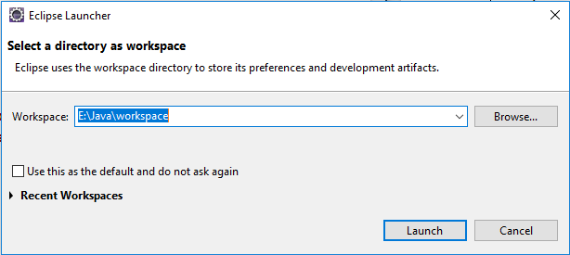
Open Eclipse
Set the workspace path carefully.
Do not choose any folder whose whole path contains any Korean characters.
Do not put any Korean characters in the workspace path.

Slide 4
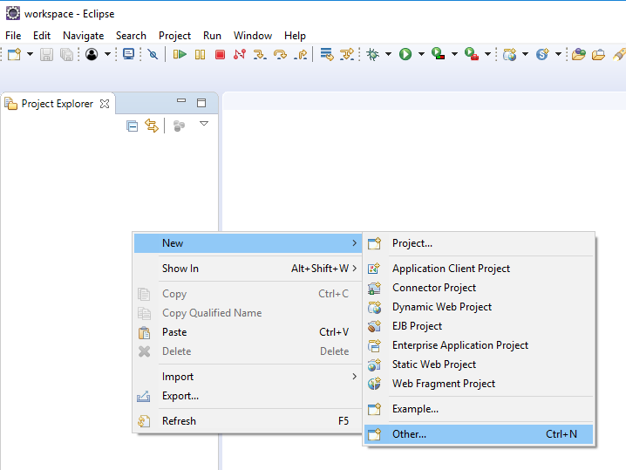
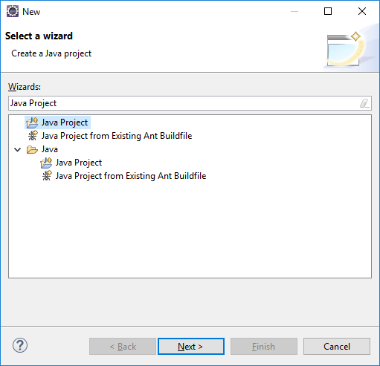
Create an Eclipse Java Project (1)
In Project Explorer
Pop-up menu → New → Java Project (if not there, go to Other and seach Java Project in Wizards.)
Click Next

Slide 5
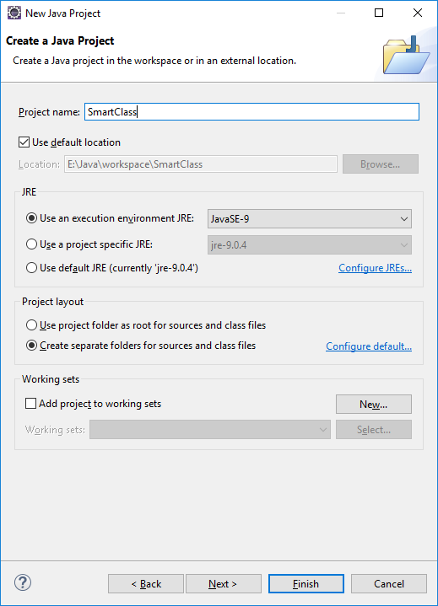
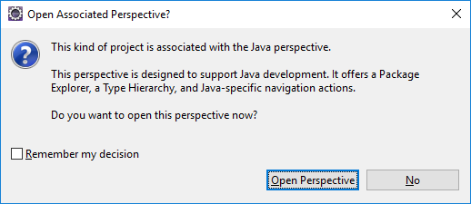
Create an Eclipse Java Project (2)
Type a project name you want to use.
e.g., SmartClass
Click Finish
Click 'Open Perspective' if you see the alert window

Slide 6
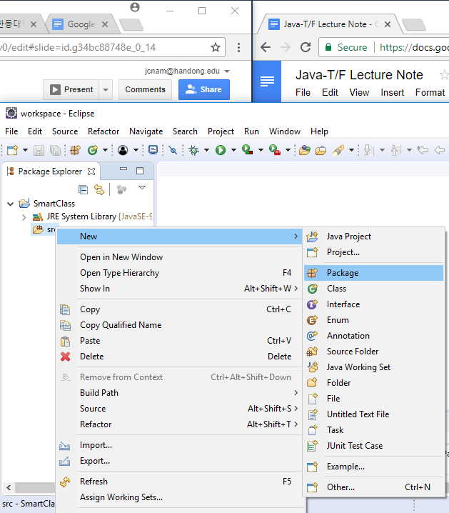
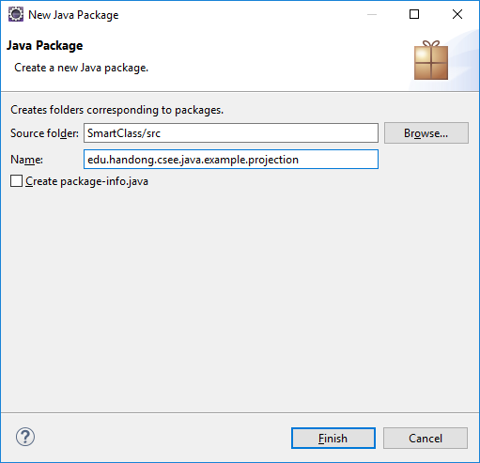
2. Create a package in the 'src' folder
Pop-up menu on the src folder → New → Package
Put a package name in "Name:"
A package name usually use a domain-like name in a reverse order to make our package unique in the world. e.g., edu.handong.csee.java.mypackage, net.lifove.android.app.lifovebible

Slide 7
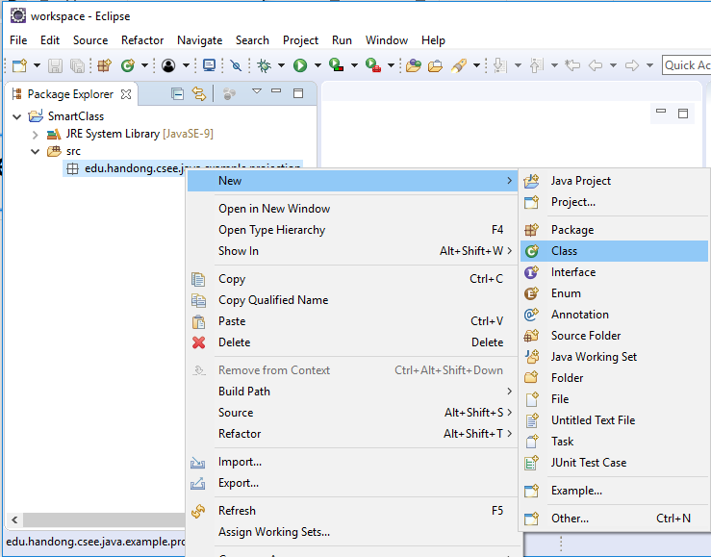
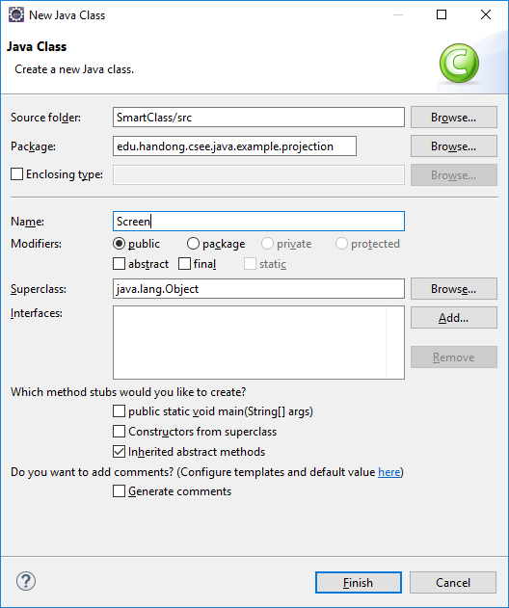
3. Add a Java class in the package
Pop-up on the package where you want to add a java source file for a class. → New → Class
Put a class name in "Name:" → Finish
The first character must be a capital. e.g., Screen (O) screen (X)

Slide 8
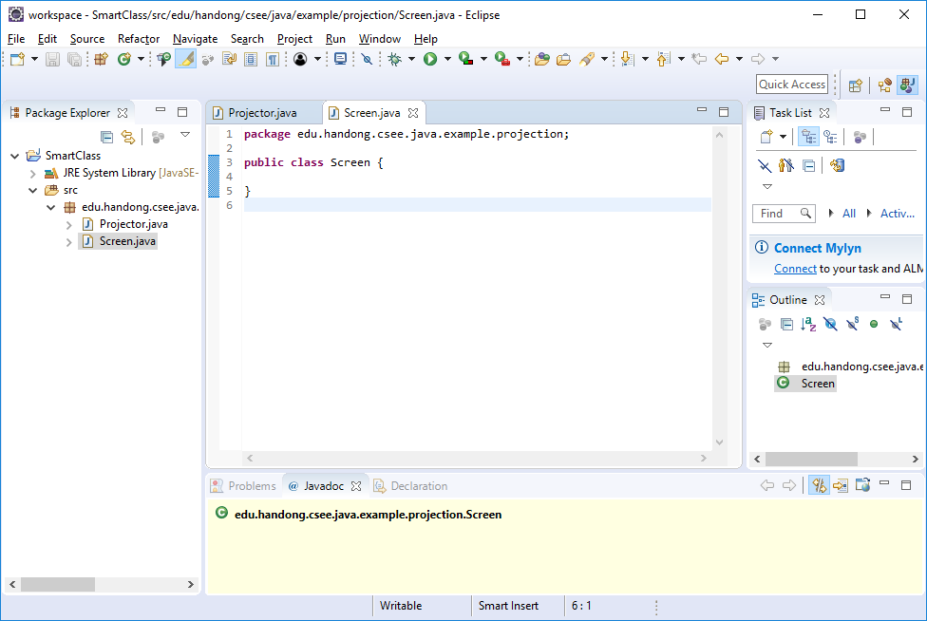
3. Add a Java class in the package (2)
Then, we can have a java source file in the editor.

Slide 9
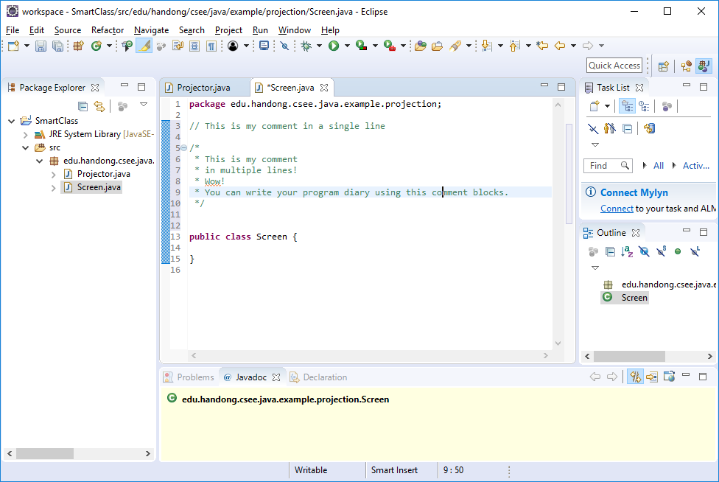
4. Add comments and Javadoc comments
// : for the single line comment
/* */: for the multiple-line comment (Start with '/*' and end with '*/')

Slide 10
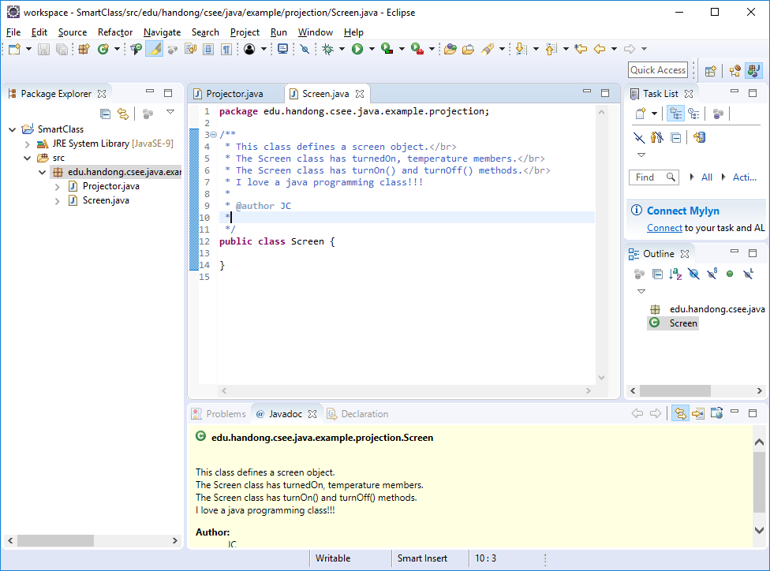
4. Add comments and Javadoc comments (2)
Javadoc comment (Slides: How to generate javadoc htmls https://goo.gl/dbfc6m)
/** */: for the javadoc comments (Start with '/**' and end with '*/')

Slide 11
5. Define a class name and its block
We already added a class block in Eclipse (See Step 3)
A class block consists of:
modifier: public or nothing
public means my class can be used by other developers by importing it in other developers java code.
If we don't write any modifier, this means my class can be used only within its package. So we say the class is protected.
class: Just tells to JVM we define a class.
any name given by me
block { … }
 | public | (default)
Same package | O | O
Others | O

Slide 12
5. Define a class name and its block (2)
A java file may contain more than two classes but it must have only one public class.
The first character of a class name must be a capital
e.g., MyClass (O), myClass (X)
A java file name must be same as a public class name.
MyClass.java
package edu.handong.csee.java.lab; // the first character of a class name must be a capital. public class MyClass { // <modifiers> class <Name> } class MyProtectedClass { }

Slide 13
6. Implement a class (Define class members)
Add an instance variable
An instance variable: data for a class a.k.a a member variable, a field
Naming convention
Starts with a lowercase, m, as a prefix. the 'm' stands for a 'm'ember variable.
Than put an actual name.
Use a uppercase for the first character of a word.
There must not be a space and avoid to use special characters except for '_' for one variable name
e.g. mName, mMyVariable_1, mMyProjector, mCounterForTurnedOnProjectors,...
Add a method
A method: an action for a class
Naming convention
Use a lowercase for the first character of the name
Use a uppercase of the first character of the second word and its all next words
e.g., turnOnMyProjector, turnOffMyProjector, getTemperature, setTemperature,...
<modifiers> <return type> <method name>(parameters)
e.g., public void myMethod() {}

Slide 14
6. Implement a class
Decide access modifiers for a method.
Add a return (output) type
void: nothing to output
...
 | public | protected | (default) | private
Insider class | O | O | O | O
Same Package Class | O | O | O | X
Same Package Sub-Class | O | O | O | X
World | O | X | X | X

Slide 15
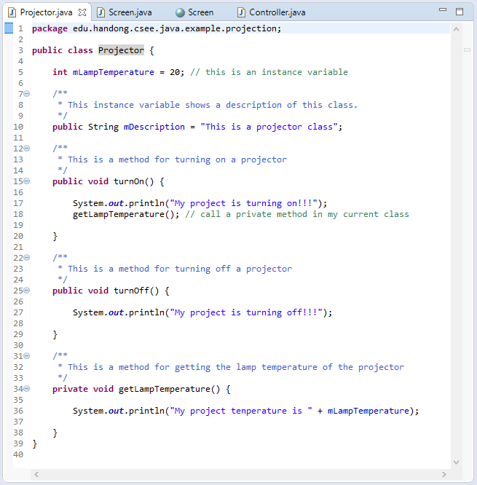
6. Implement a class

Slide 16
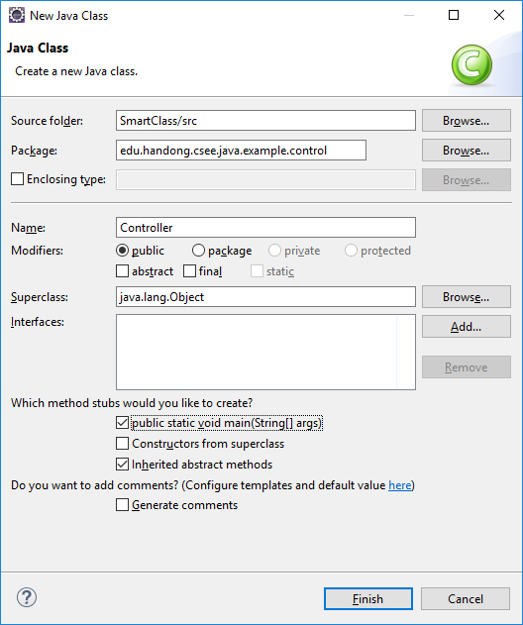
7. Create a main method in the class that starts our program.
We need a entry point to execute a java program.
We can add a main method in every class
But each class cannot have more than one main methods.
the main method always look same!
When you add a new class, you can just need to tick this option to add the main method.
public static void main(String[] args) { }

Slide 17
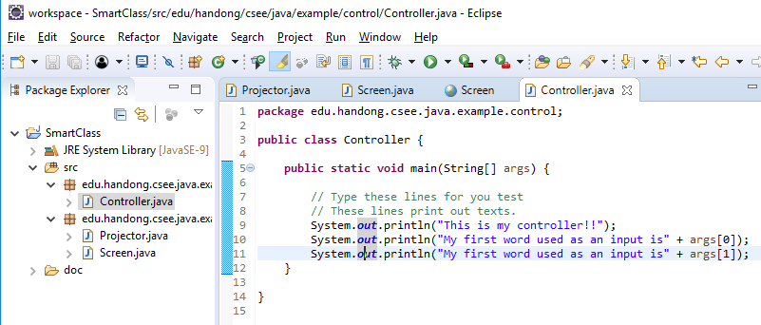
7. Create a main method in the class that starts our program. (2)
Now you can run your program because you have a main method!!!

Slide 18
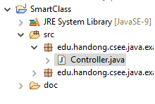
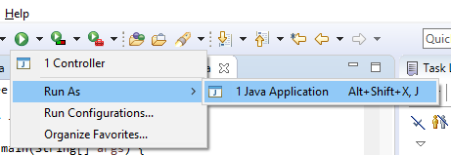
7. Create a main method in the class that starts our program. (3)
Various ways to run your program in Eclipse!
Choose and open a java file that has a main method in Project Explorer.
Then click a play button or "Run as → 1 Java Application" or Ctrl+F11

Slide 19
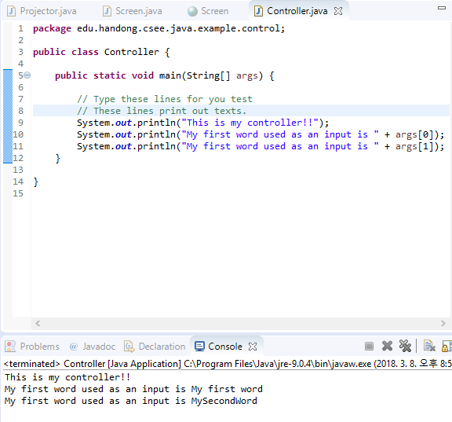

7. Create a main method in the class that starts our program. (3)
You may not get the following results because you did not add inputs.
See the next slides to solve the problem.
Error Results →

Slide 20
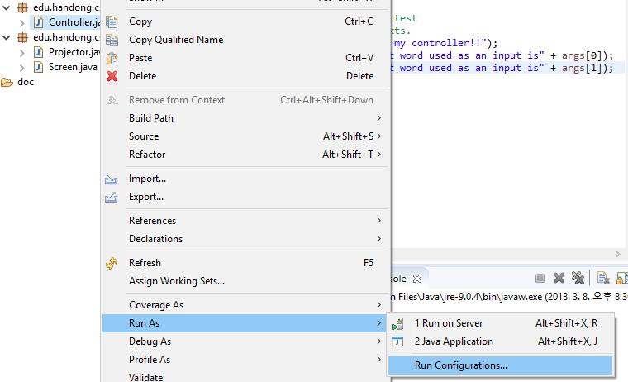
7. Create a main method in the class that starts our program. (3)
public static void main(String[] args)
String[] args
Initial text input when we run a program
it contains a series of words.
Let's add our initial input when running the java program in Eclipse
Popup menu on a java file having a main method → Run as → Run Configuration

Slide 21
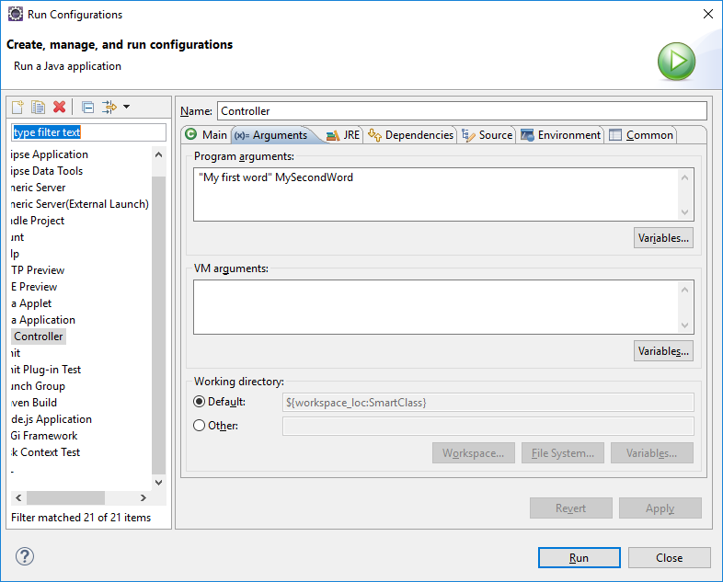
7. Create a main method in the class that starts our program. (4)
"My first word" → First input for the main method. Considered as one word as grouped by using "".
MySecondWord → Second input for the main method. Considered as one word because there is no space between real words.

Slide 22
7. Create a main method in the class that starts our program. (3)
Results →

Slide 23
8. Instantiate an object
To instantiate an object
<Class name we want to create as an instance> <instance name we use in our code> = new <Class name>()
e.g.,
Projector myProjector = new Projector();
Instantiate of an object may have some input
e.g.,
Computer myComputer = new Computer("name");
Constructors
new Projector() is calling a constructor
A constructor is a special method that creates an instance. (We will learn it later in detail.)
Slides: https://goo.gl/at77hR

Slide 24
9. Call members of an instance (Method invocation and access fields)
We can run actions of an object
Method calls
Method invocations
We can access public instance variables (fields).

Slide 25
